Slide 1

Automating Analysis And Resolution Of Data Center Network Issues With Cisco Network Assurance Engine APIs
Gayathri Pandyaram
Technical Leader, DCNBU Ecosystem, Cisco

Slide 2

Gayathri Pandyaram
Technical Leader, Cisco
Gayathri is Technical Leader in the DCNBU Ecosystem Team. She works with technology partners and Engineering to provide comprehensive solutions for Data Center customers.
gpandyar@cisco.com

Slide 3
Agenda
Challenges In A Modern Data Center
A Solution
How Can I Use The Solution Programmatically?
Hands-on
A Use Case
Conclusion

Slide 4
Modern Data Centers

Slide 5
















Network Controller
Spine Switch
Virtualization
Modern Data Center
Cloud Infrastructure
Leaf Switch
Workloads
End Points

Slide 6
Data Centers Are Undergoing Rapid Transformation Digitization, Cloud, Mobile Creating New Demands of IT
Scale
10Ks VMs, 100s of Apps, distributed apps, 1M+ policies
Complexity
Multi-DC, multi-tenant, hybrid, virtualized, heterogeneous
Rate of Change
VM mobility, app migration, dynamic scaling, self service portals

Slide 7
Infrastructure has Evolved with Mature Orchestration Engines
Intent
Automated
Controllers / Orchestrators
Highly Scalable
…
Virtualized
Infrastructure
Policy-Based
VM

Slide 8
But, Operational Paradigms are still Rudimentary
Intent Frequently Breaks…
We Always React…
Leaving Us With…
Operational
Troubleshoot
Security
Scramble to fix it
An Inability to Assure Intent Proactively
Compliance
Fail audits
Change
Undo changes

Slide 9
... Creating a Major Assurance Gap
Intent
1
How can I ensure I didn’t create errors due to my changes?
Controllers / Orchestrators
…
2
How do I easily understand the state of my dynamic infrastructure?
Infrastructure
VM
3
How do I rapidly correlate policy and state to rapidly root cause issues?

Slide 10
How Can I …
… have confidence in my changes?
… diagnose issues before they cause outages?
… plan my network?
… ensure compliance?
… pass audits?
…
How Can I Assure Intent?

Slide 11
A Solution – Intent Based Networking

Slide 12
Intent Assurance
The confidence that the infrastructure is doing what you intended it to do
Intent Encompasses Data Center Operations
Configs, Changes, Routing, VMs, Security, … Compliance, Audits

Slide 13

Introducing Cisco Network Assurance Engine
Based on mathematical models of the network
Continuously verifies and validates the entire network
Proactively delivers the confidence that the network is operating correctly
Comprehensive, Intelligent, Continuous

Slide 14
Cisco Network Assurance Engine: How It Works
Data Collection
Comprehensive Network Modeling
Intelligent Analysis
Captures all non-packet data: intent, policy, state across data center network
Mathematically accurate models spanning underlay, overlay and virtualization layers
5000+ domain knowledge-based error scenarios built-in, codified remediation steps
Notes:
Let’s double-click to see how it works.
1. Starting from the left – what data do we collect. Candid goes to every leaf, every spine in the network and collects all the configurations and control-place state, data-plane state, even hardware state like TCAM tables, VLAN tables etc. From the controller we pick up the entire policy and configs and a representation of the intent. In addition, we have the implicit intent based on the expected network behavior.
2. With all this we now build the comprehensive network model – underlay, overlay, and tenancy layers.
3. Against this model – we run checks based on 30+ years of Cisco operational domain experience. These checks are based on 3 things: i) our expertise on how networks and our hardware should correctly operate, - there should be no routing loops, or no overlapping subnets in a VRFs of duplicate Ips and so on. ii) best design practices that we learn from our AS teams. If you want a subnet to talk externally what are all the BD and L3out configs required, or all the access policies required to correctly deploy an EPG iii) finally, from our TAC cases. The 10% of of failure scenarios that cause 90% of failures in the field. Bringing this collective knowledge for all our customers.
Every 15 mins orso, the engine builds the most real-time model of the network, and runs these checks against that model – like an intelligent robot watching your back, always checking the network for correctness.

Slide 15
Continuous Intent Assurance
Intent
Continuous
Verification &
Validation
Intent
Controllers / Orchestrators
…
Policy
State
Infrastructure
Core building block for Closed Loop Intent-based Networks
VM

Slide 16
Network Assurance Engine SmartEvents
Every SmartEvent Consists of
Severity, Category, SubCategory, Mnemonic
Description
Impact
Affected Objects
Checks
Remediation Suggestion

Slide 17
How Can I Use The Solution Programmatically?

Slide 18
Network Assurance Engine APIs

Slide 19
Need for NAE APIs
Ease of use
Consistency
Reliability
Standardization
Programmability

Slide 20
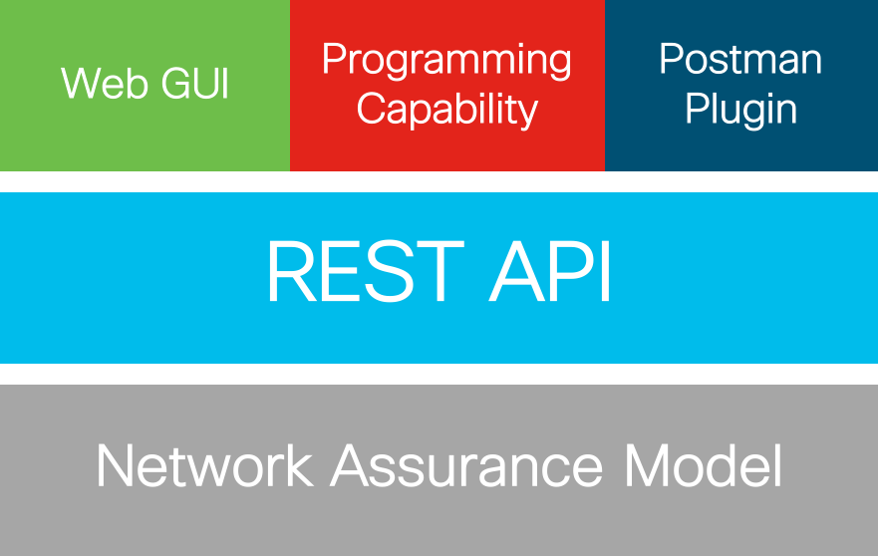
NAE APIs
Same objects irrespective of interface
True REST API targeting “resources”
Programmatic access to all assurance models
Fully automatable management of NAE

Slide 21
How do NAE APIs work?
Use REST (Representational State Transfer)
Establish a connection with NAE instance & get auth cookie ➔ session remains valid for 15 minutes
Use URIs with necessary input parameters

Slide 22
NAE APIs Hands-On (Postman)

Slide 23
NAE APIs Hands-On (Python)

Slide 24
A Use Case – ServiceNow

Slide 25



Data Center Maintenance
Item 1
Item 2
Users
Networking
Operations/Services
Infrastructure
Item 3
Item 4

Slide 26
NAE-ServiceNow Demo

Slide 27
Conclusion
Consistent REST APIs for both GUI and programmatic access
Easy to use
Documentation, Swagger for understanding

Slide 28
Additional Notes
Documentation available on the device
Settings (Gear Icon)→ Appliance Documentation
API User Guide @ DevNet
https://developer.cisco.com/docs/network-assurance-engine/#!introduction/cisco-network-assurance-engine-rest-api-user-guide
Swagger UI available on the device
http://{appliance-ip}/api/v1/swagger-ui.html
Workshop material available
https://github.com/gpandyar/NAE-DevNetCreate19

